Slide 1
Biometric Authentication
Anjali Kanwasi
23652008
Seminar – 1 (OBC108JULY23)
Notes:
Hi I’m Anjali Kanwasi.
I’m a pursuing BCA. I’m currently in semester 1.
I have selected my topic as Biometric Authentication.
As now everything is dependent on data and any leak in personal data can cause unimaginable threats to the person.
To protect our personal data from theft or any breach we have various types of Authentication.
Biometric is one of the most relied of all the available authentications till date.
Most of us use some type of biometric authentication daily in smartphone, some uses fingerprint, some face recognition and some iris scan.

Slide 2
Contents:
What is Biometrics?
What is Biometric Authentication?
Types of Biometric Authentication
Characteristics of Biometric Authentication:
Physical Characteristics
Behavioral Characteristics
Advantages & Disadvantages
Where we can use Biometric Authentication
Notes:
Moving on I will be talking about these points.
First, What is Biometric Authentication?
Types of Biometric Authentication
Characteristics of Biometric Authentication:
Which are Physical characteristics and behavioral characteristics.
Then Advantages and disadvantages
And where we can use biometric authentication.

Slide 3

Biometric Authentication An Introduction
Notes:
So Biometric authentication – an intorduction
Providing security has become a challenging factor in today’s advanced computerized engineering and Technological environment. Traditional methods like memorizing passwords, carrying ID cards have their own draw backs.
Biometric Authentication has become more and more reliable, secured and most convenient tool. Simply Biometrics refers to establishing identity based on the physical and behavioral characteristics of an individual such as face, fingerprint, hand geometry, iris, keystroke, signature, voice, etc. Biometric system offers several advantages over traditional authentication schemes. They are inherently more reliable than password-based authentication as Biometric traits cannot be lost or forgotten.

Slide 4
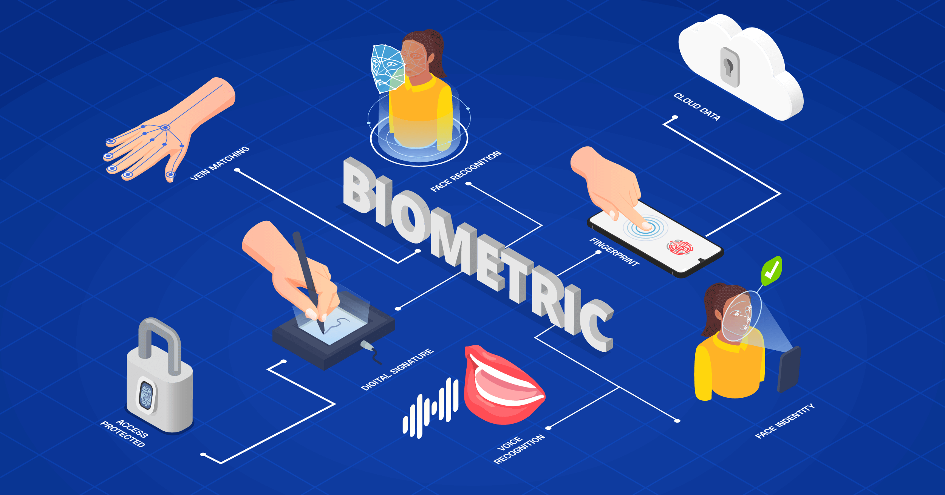
What is Biometrics?
Notes:
So, first question that comes to mind is what is biometrics?
We can break down the term "biometrics" to get a better understanding of what it is. “Bio” stems from biology, while “metrics” are units of measurement. Put the two together and you have biometrics, which measure the unique physical and behavioral characteristics of a living creature.
Biometric data is information that can help identify you based on your physical or behavioral traits. For example, hospitals can use biometric data to identify patients and monitor their well-being. Companies like Apple add biometric sensors to many of their devices that can identify users via fingerprint and facial recognition software.

Slide 5
What is Biometric Authentication?
Bio authentication, or biometric authentication, is a method of authentication based on something biological to the human being. Biometric authentication is another form of multi-factor authentication (providing several separate pieces of evidence proving who you are) and can be used in conjunction with another form of authentication, such as password.
Notes:
And
Bio authentication, or biometric authentication, is a method of authentication based on something biological to the human being. Biometric authentication is another form of multi-factor authentication (providing several separate pieces of evidence proving who you are) and can be used in conjunction with another form of authentication, such as password.

Slide 6
What is Biometric Authentication?
Common types of biometric authentication are increasingly being built into consumer devices, especially computers and smartphone. Biometric authentication technologies are also being used by governments and private corporations in secure areas, including at military bases, in airports, and at ports of entry when crossing national borders.
Notes:
Common types of biometric authentication are increasingly being built into consumer devices, especially computers and smartphone. Biometric authentication technologies are also being used by governments and private corporations in secure areas, including at military bases, in airports, and at ports of entry when crossing national borders.

Slide 7



Types of Biometric Authentication
These are characteristics of your person that are unique to you, that you were born with, and are nearly impossible to change outside of major damage or surgical procedures. These would include things like your fingerprints, DNA, and retinal patterns.
Type 1 – Something You Know – includes passwords, PINs, combinations, code words, or secret handshakes. Anything that you can remember and then type, say, do, perform, or otherwise recall when needed falls into this category.
Type 2 – Something You Have – includes all items that are physical objects, such as keys, smart phones, smart cards, USB drives, and token devices. (A token device produces a time-based PIN or can compute a response from a challenge number issued by the server).
Type 3 – Something You Are – includes any part of the human body that can be offered for verification, such as fingerprints, palm scanning, facial recognition, retina scans, iris scans and voice verification.
Notes:
These are characteristics of your person that are unique to you, that you were born with, and are nearly impossible to change outside of major damage or surgical procedures. These would include things like your fingerprints, DNA, and retinal patterns.
Type 1 – Something You Know – includes passwords, PINs, combinations, code words, or secret handshakes. Anything that you can remember and then type, say, do, perform, or otherwise recall when needed falls into this category.
Type 2 – Something You Have – includes all items that are physical objects, such as keys, smart phones, smart cards, USB drives, and token devices. (A token device produces a time-based PIN or can compute a response from a challenge number issued by the server).
Type 3 – Something You Are – includes any part of the human body that can be offered for verification, such as fingerprints, palm scanning, facial recognition, retina scans, iris scans and voice verification.

Slide 8
Types of Biometric Authentication
By combining two or three factors from these three categories, a multi-factor authentication is crafted. Multi-factor authentication is preferred, as it is much more difficult for an intruder to overcome. With just a password, an attacker only has to have a single attack skill and wage a single successful attack to impersonate the victim. With multi-factor authentication, the attacker must have multiple attack skills and wage multiple successful attacks simultaneously in order to impersonate the victim. This is extremely difficult and, thus, a more resilient logon solution.
Notes:
By combining two or three factors from these three categories, a multi-factor authentication is crafted. Multi-factor authentication is preferred, as it is much more difficult for an intruder to overcome. With just a password, an attacker only has to have a single attack skill and wage a single successful attack to impersonate the victim. With multi-factor authentication, the attacker must have multiple attack skills and wage multiple successful attacks simultaneously in order to impersonate the victim. This is extremely difficult and, thus, a more resilient logon solution.

Slide 9
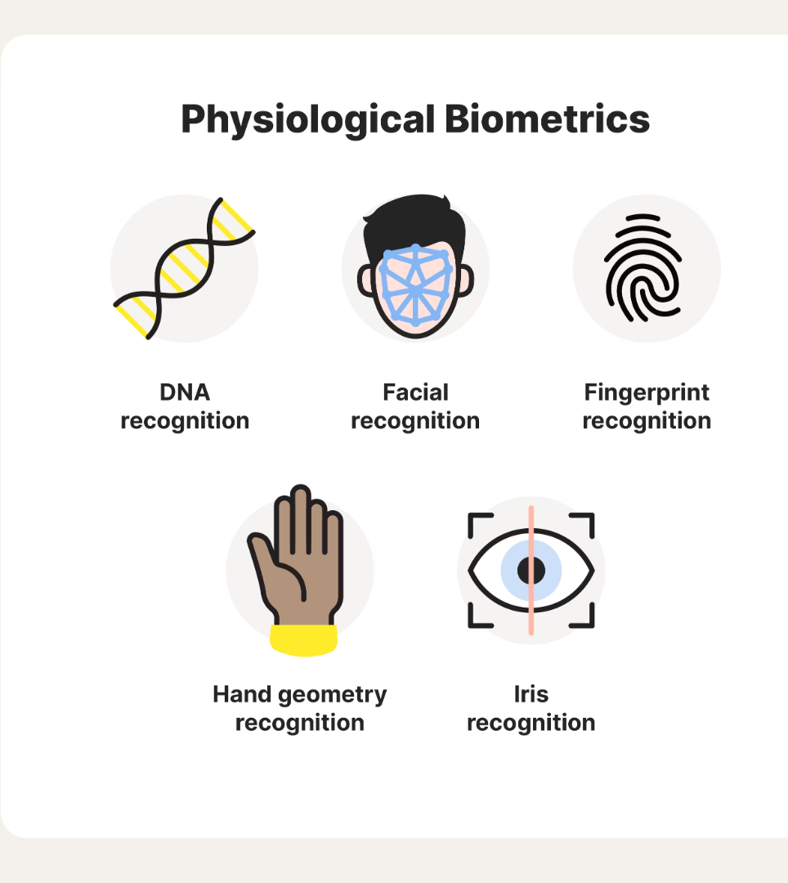
Physical Characteristics of Biometric Authentication
Biometric authentication devices rely on physical characteristics such as a:
DNA
Facial patterns
Fingerprint
Iris
Retinal Patterns
Vein Pattern
Palm Geometry
Notes:
Physiological biometrics can recognize our physical attributes. Several prominent examples include:
DNA recognition: identifies people based on DNA found in their blood, hair, and mucus
Facial recognition: detects users based on their facial features
Fingerprint recognition: creates a profile by mapping the ridges on your fingertips
Hand geometry: verifies users via the shape and size of their hands
Iris recognition: relies on distinct iris patterns to identify users
Our genes play a big part in determining our physical features—which means they’re also an important factor for systems that rely on physiological biometrics.

Slide 10
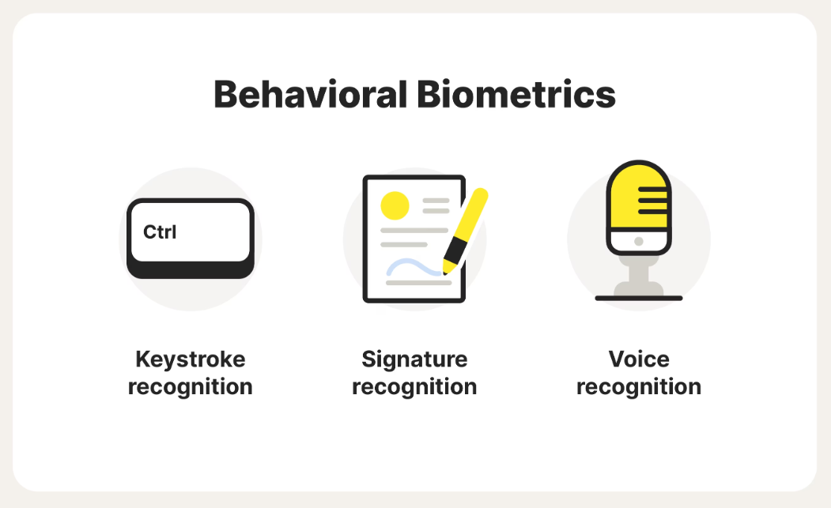
Behavioral Characteristics of Biometric Authentication
Behavioral biometrics is the field of study related to the measure of uniquely identifying and measurable patterns in the human activities. The term contrasts with physical biometrics, which involves innate human characteristics such as fingerprints or iris patterns.
Behavioral biometric verification methods include keystroke dynamics, gait analysis, voice ID, mouse use characteristics, signature analysis and cognitive biometrics. Behavioral biometrics are used for secure authentication in financial institutions, businesses, government facilities and retail point of sale (POS), as well as an increasing number of other environments.
Notes:
Behavioral biometrics is the field of study related to the measure of uniquely identifying and measurable patterns in the human activities. The term contrasts with physical biometrics, which involves innate human characteristics such as fingerprints or iris patterns.
Behavioral biometric verification methods include keystroke dynamics, gait analysis, voice ID, mouse use characteristics, signature analysis and cognitive biometrics. Behavioral biometrics are used for secure authentication in financial institutions, businesses, government facilities and retail point of sale (POS), as well as an increasing number of other environments.
Keystroke recognition verifies users based on their typing tendencies, like speed and rhythm
Signature recognition authenticates users based on their penmanship
Voice recognition identifies users based on their diction and speech patterns
We’re all capable of recognizing a person based on their voice or the way they jot down their name. Behavioral biometric systems can essentially do the same thing.

Slide 11
Advantages & Disadvantages
Passwords and PINs, are easy to forget causing people to write them down and consequently can be stolen and can at times be hacked. With biometrics technology, fingerprints won’t be lost and can’t be attained and copied by someone aiming to illegally gain access.
Biometric technology can be used to avert illicit access to ATMs, cellular phones, smart cards, desktop PCs, workstations and computer networks.
Biometric technology can be effectively employed in forensics. It is a useful technology that can be utilized for criminal identification and prison security.
Biometric technology can be used in a lot of industries, such as healthcare, civil ID, business, schools, financial industry, etc. A lot of countries have already used biometric technology for voter registration, national ID and national health care, or e-passport projects.
Biometric technology is less exposed to damage and sudden changes. The behavioral and physical elements accessed for biometric verification like iris/retina, voice, pulse, DNA, vein, etc. are less in danger to damage and sudden changes.
Notes:
Talking about advantages and disadvantages
Passwords and PINs, are easy to forget causing people to write them down and consequently can be stolen and can at times be hacked. With biometrics technology, fingerprints won’t be lost and can’t be attained and copied by someone aiming to illegally gain access.
Biometric technology can be used to avert illicit access to ATMs, cellular phones, smart cards, desktop PCs, workstations and computer networks.
Biometric technology can be effectively employed in forensics. It is a useful technology that can be utilized for criminal identification and prison security.
Biometric technology can be used in a lot of industries, such as healthcare, civil ID, business, schools, financial industry, etc. A lot of countries have already used biometric technology for voter registration, national ID and national health care, or e-passport projects.
Biometric technology is less exposed to damage and sudden changes. The behavioral and physical elements accessed for biometric verification like iris/retina, voice, pulse, DNA, vein, etc. are less in danger to damage and sudden changes.

Slide 12
Advantages & Disadvantages
“Master fingerprints” can trick many phones and scanners
When you first register a fingerprint, the device will ask you for multiple presses from different angles. These samples will then be used as the original data set to compare with subsequent unlock attempts. However, smartphone sensors are small, so they often rely on partial matches of fingerprints.
Biometrics last a lifetime
You can always change your password if somebody learns it, but there’s no way to modify your iris, retina or fingerprint. Once somebody has a working copy of these, there’s not much you can do to stay safe, other than switching to passwords or using another finger.
Vulnerabilities in biometric authentication software
A couple of years ago, security researchers discovered weaknesses in Android devices that allowed them to remotely extract a user’s fingerprint, use backdoors in the software to hijack mobile payments even install malware.
Missing body part problem
Notes:
“Master fingerprints” can trick many phones and scanners
When you first register a fingerprint, the device will ask you for multiple presses from different angles. These samples will then be used as the original data set to compare with subsequent unlock attempts. However, smartphone sensors are small, so they often rely on partial matches of fingerprints.
Biometrics last a lifetime
You can always change your password if somebody learns it, but there’s no way to modify your iris, retina or fingerprint. Once somebody has a working copy of these, there’s not much you can do to stay safe, other than switching to passwords or using another finger.
Vulnerabilities in biometric authentication software
A couple of years ago, security researchers discovered weaknesses in Android devices that allowed them to remotely extract a user’s fingerprint, use backdoors in the software to hijack mobile payments even install malware.
Missing body part problem

Slide 13
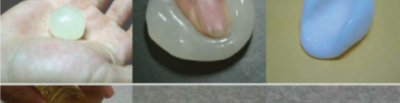
Creating a fake finger (spoofing the fingerprint)
To unlock a smartphone secured with a fingerprint, the attacker will first need to find a high-quality print, that contains a sufficient amount of specific patterns to unlock the device.
Next, an attacker will lift the fingerprint, place it on plastic laminate, and then cast a finger to fit this mold.
Once the malicious hacker creates the fake finger, all he has to do is to place it on the scanner, press with his finger to conduct electricity and then use the unlocked phone.
Notes:
Yes, it is possible to create a fake fingerprint, not easy but possible
This is how it can be done
To unlock a smartphone secured with a fingerprint, the attacker will first need to find a high-quality print, that contains a sufficient amount of specific patterns to unlock the device.
Next, an attacker will lift the fingerprint, place it on plastic laminate, and then cast a finger to fit this mold.
Once the malicious hacker creates the fake finger, all he has to do is to place it on the scanner, press with his finger to conduct electricity and then use the unlocked phone.

Slide 14
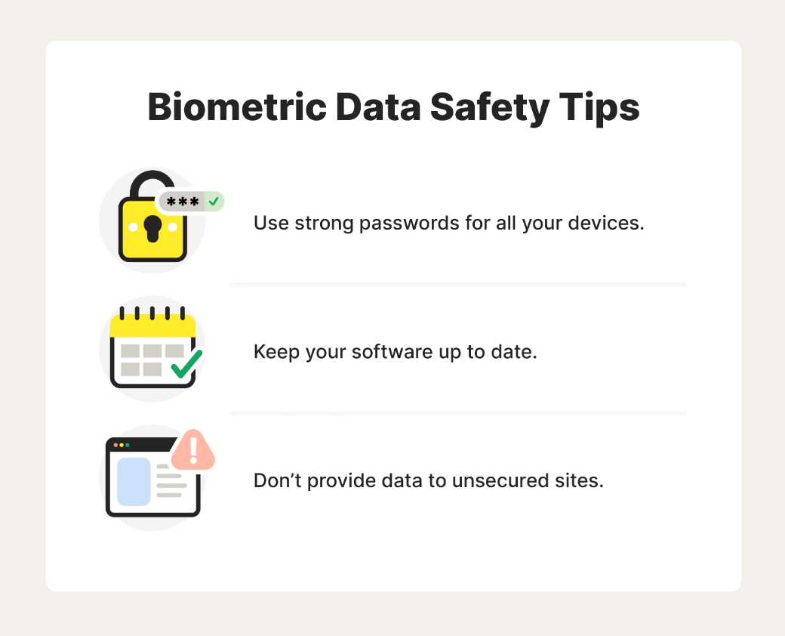
How to protect your biometric data
Notes:
Yes, That’s correct you need to protect your biometric data also.
When it comes to securing your biometric data, start by considering where it’s stored. Biometric data is typically stored on your devices.
Here are several best practices that apply to mobile devices, laptops, computers, and more.
Use strong passwords to make it harder for hackers to steal your data. Reinforcing your password and using different logins for various sites gives hackers fewer ways to access your information—including biometric data stored on your phone or computer.
Keep your software current to improve your device’s security. When an update or patch becomes available, try to install it immediately. Manufacturers often release these updates to combat new threats, which they’ll include in their patch notes.
Only provide biometric data to secure websites. Most browsers will use several methods to let you know that a site isn’t secure. Google Chrome and Safari will add the words “Not Secure” to a faulty website’s URL. You may also receive a “Your connection is not private” alert before the page can even load.
Protecting your devices will also protect your biometric data. Setting aside the time to install updates and change passwords can be worthwhile in the long run.

Slide 15

THANKYOU
Notes:
That is all from my side for the topic Biometric Authentication.
Hope you liked my presentation and content.
Thankyou for watching and listening.
This is Anjali Kanwasi Signing off.

